Slide 1
HR Data Analysis
Presenters Names:
- Mohamed Mohy
- Abdel Aziz El-Saudy
- Amr Shaaban
- Shimaa Mahmoud
- Ayat Gamil

Slide 2

Project Wireframe
Overview of User Journey:
Employees' Payroll in Los Angeles
Payroll of 685,000 Employees in Los Angeles (01-2013 to 06-2022)

Slide 3
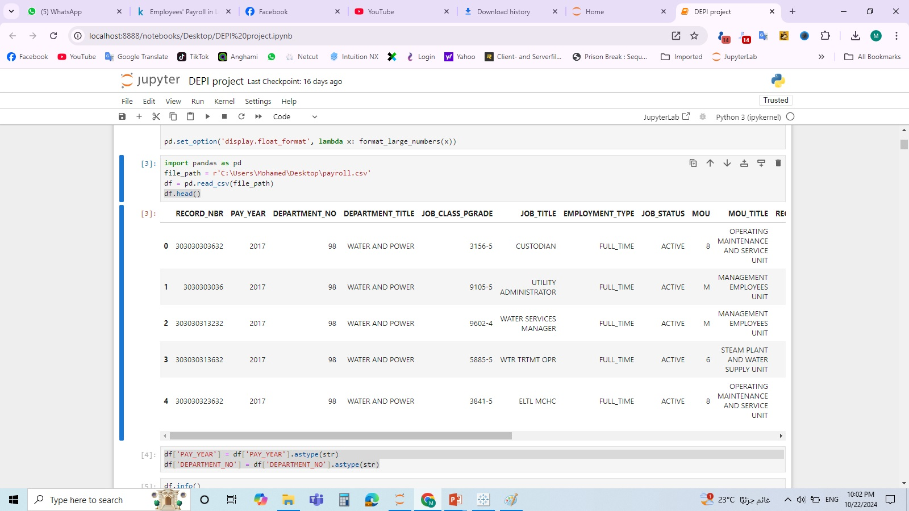
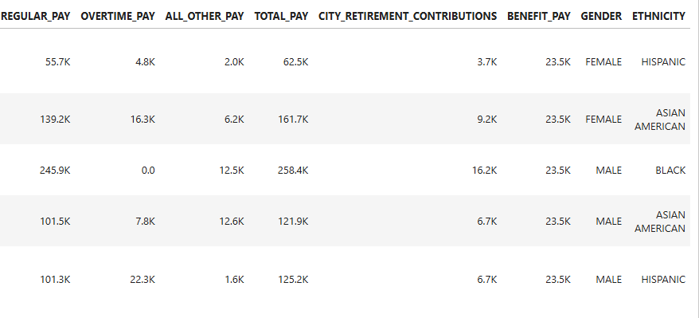
Data Structure

Slide 4
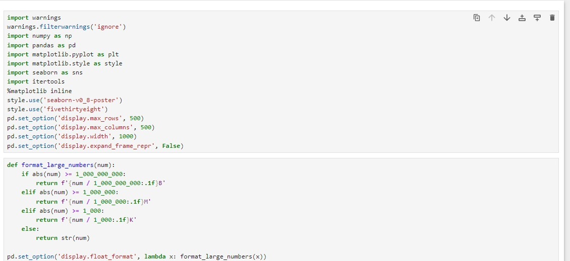
Data Structure
Data Cleaning Process

Slide 5
Data Structure
Data Cleaning Process
import pandas as pdfile_path = r'C:\Users\Mohamed\Desktop\payroll.csv‘ df = pd.read_csv(file_path) df.head()

Slide 6
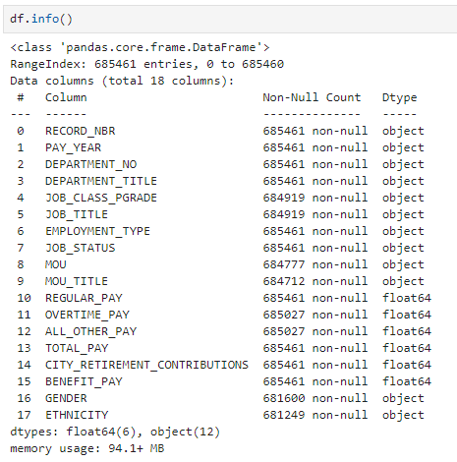
Data Structure
Data Cleaning Process

Slide 7
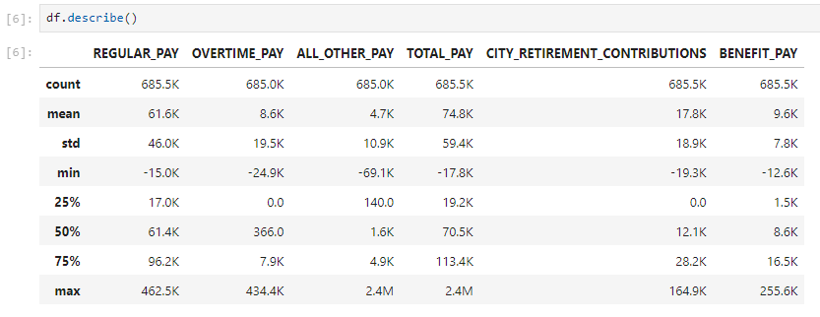
Data Structure
Data Cleaning Process

Slide 8
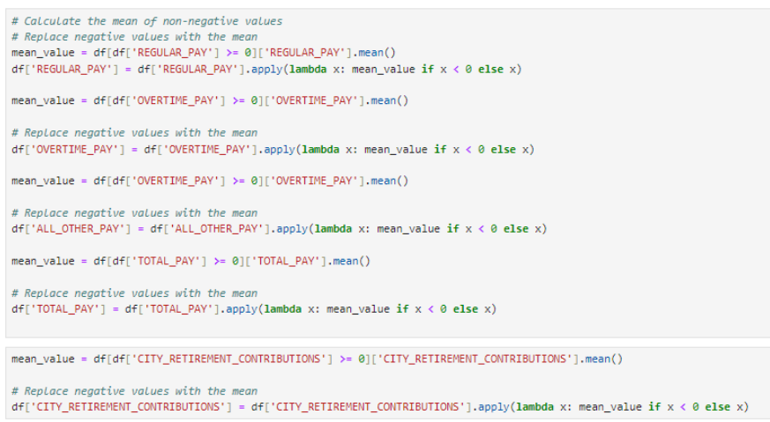
Data Structure
Data Cleaning Process

Slide 9
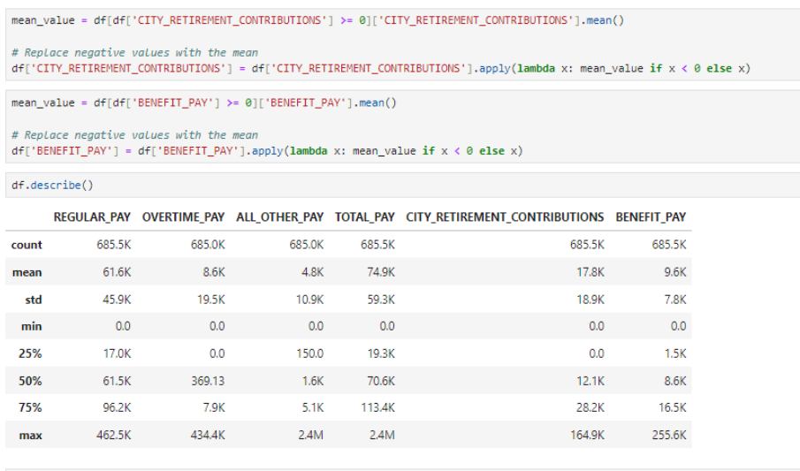
Data Structure
Data Cleaning Process

Slide 10
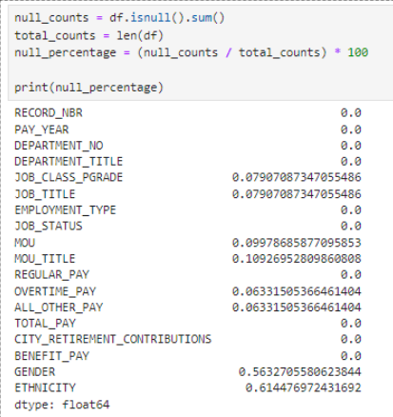
Data Structure
Data Cleaning Process

Slide 11
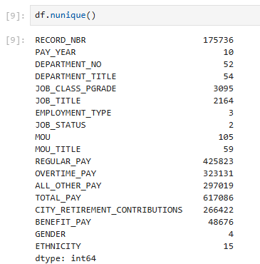
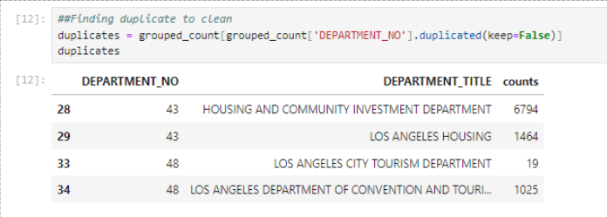
Data Structure
Data Cleaning Process
df['DEPARTMENT_TITLE'] = df['DEPARTMENT_TITLE'].replace({ 'LOS ANGELES HOUSING': 'HOUSING AND COMMUNITY INVESTMENT DEPARTMENT', 'LOS ANGELES CITY TOURISM DEPARTMENT': 'LOS ANGELES CITY TOURISM DEPARTMENT '})
df.head()

Slide 12
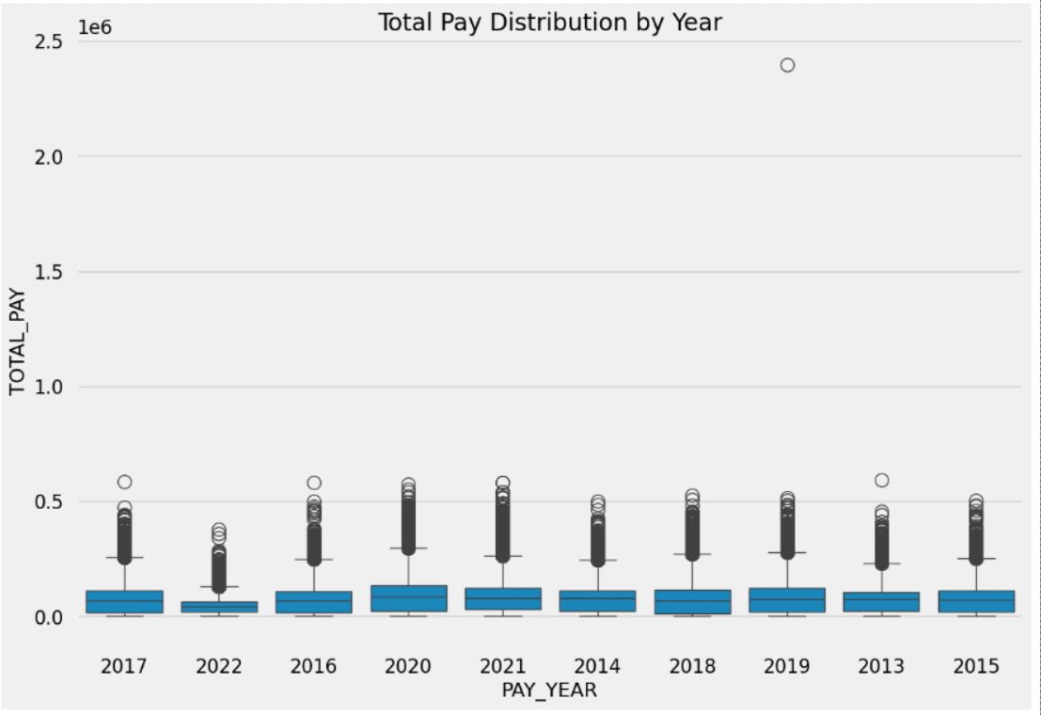
Data Structure
Data Cleaning Process
import seaborn as snssns.boxplot(x='PAY_YEAR', y='TOTAL_PAY', data=df)plt.title('Total Pay Distribution by Year')plt.show()

Slide 13
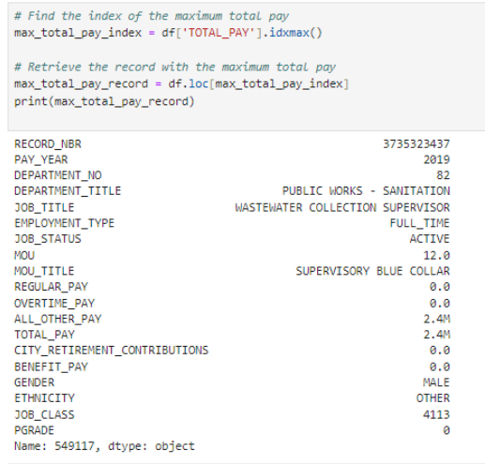
Data Structure
Data Cleaning Process
# Find the index of the maximum total pay max_total_pay_index = df['TOTAL_PAY'].idxmax() # Retrieve the record with the maximum total paymax_total_pay_record = df.loc[max_total_pay_index]print(max_total_pay_record)

Slide 14
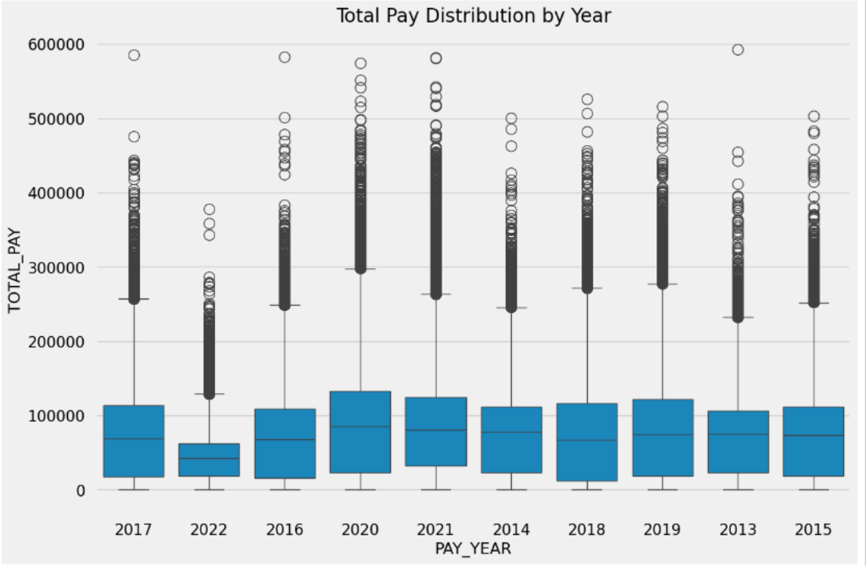
Data Structure
Data Cleaning Process
import seaborn as snsimport matplotlib.pyplot as plt# Assuming df is your DataFrame and you want to exclude rows with RECORD_NBR 3735323437df_filtered = df[df['RECORD_NBR'] != 3735323437]sns.boxplot(x='PAY_YEAR', y='TOTAL_PAY', data=df_filtered)plt.title('Total Pay Distribution by Year')plt.show()

Slide 15
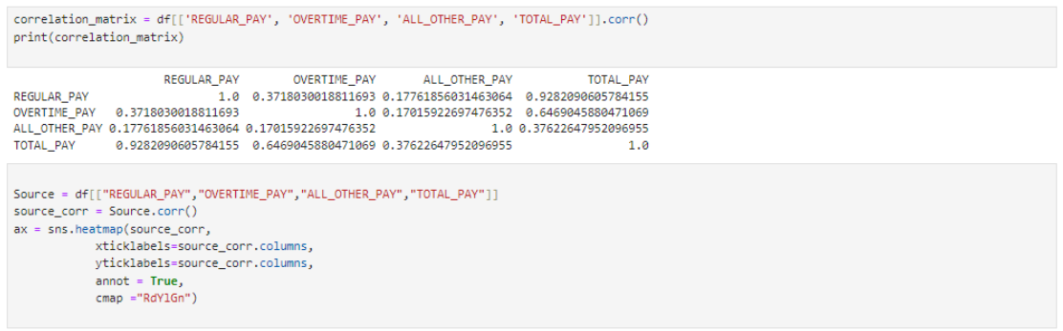
Data Structure
Data Cleaning Process

Slide 16
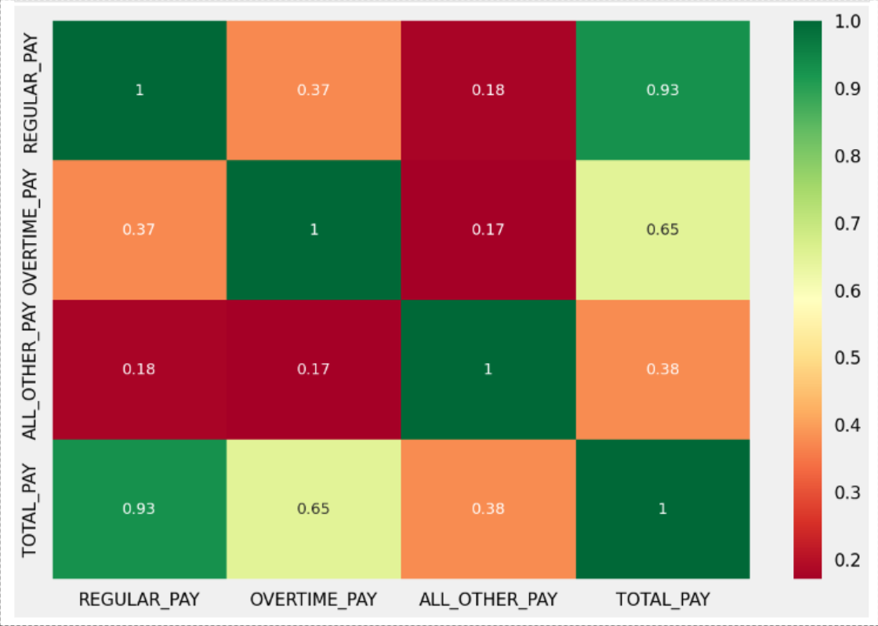
Data Structure
Data Cleaning Process

Slide 17
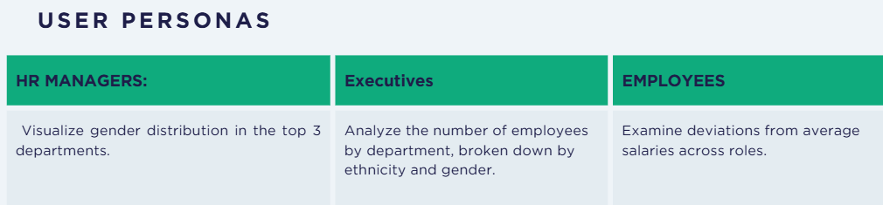
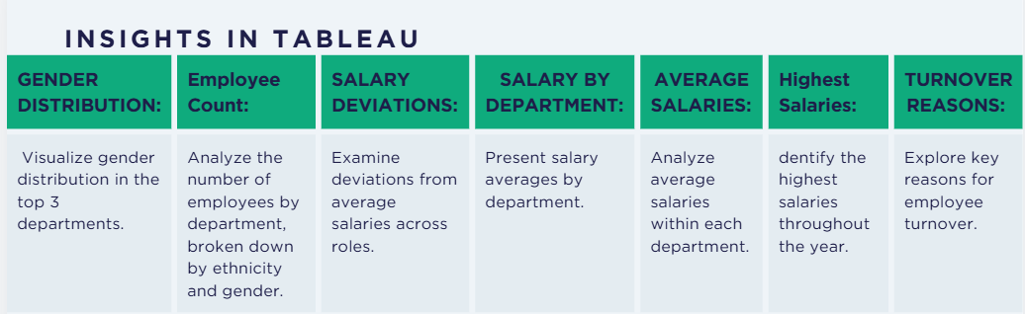
End Users + Features
User Personas
HR Managers: Focus on employee performance, retention, and reporting.
Executives: Seek strategic insights to inform decision-making.
Employees: Interested in their performance metrics and growth opportunities.
Insights in Tableau
Gender Distribution: Visualize gender distribution in the top 3 departments.
Employee Count: Analyze the number of employees by department, broken down by ethnicity and gender.
Salary Deviations: Examine deviations from average salaries across roles.
Salary by Department: Present salary averages by department.
Average Salaries: Analyze average salaries within each department.
Highest Salaries: Identify the highest salaries throughout the year.
Turnover Reasons: Explore key reasons for employee turnover.

Slide 18
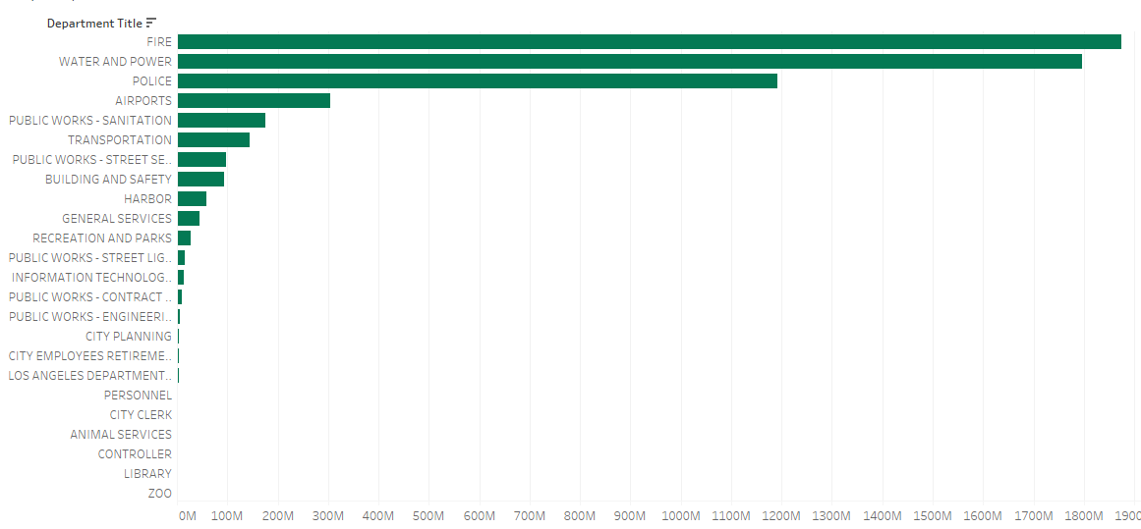
End Users + Features
User Personas
HR Managers: Focus on employee performance, retention, and reporting.
Executives: Seek strategic insights to inform decision-making.
Employees: Interested in their performance metrics and growth opportunities.
Insights in Tableau
Gender Distribution: Visualize gender distribution in the top 3 departments.
Employee Count: Analyze the number of employees by department, broken down by ethnicity and gender.
Salary Deviations: Examine deviations from average salaries across roles.
Salary by Department: Present salary averages by department.
Average Salaries: Analyze average salaries within each department.
Highest Salaries: Identify the highest salaries throughout the year.
Turnover Reasons: Explore key reasons for employee turnover.
50% of total payments

Slide 19
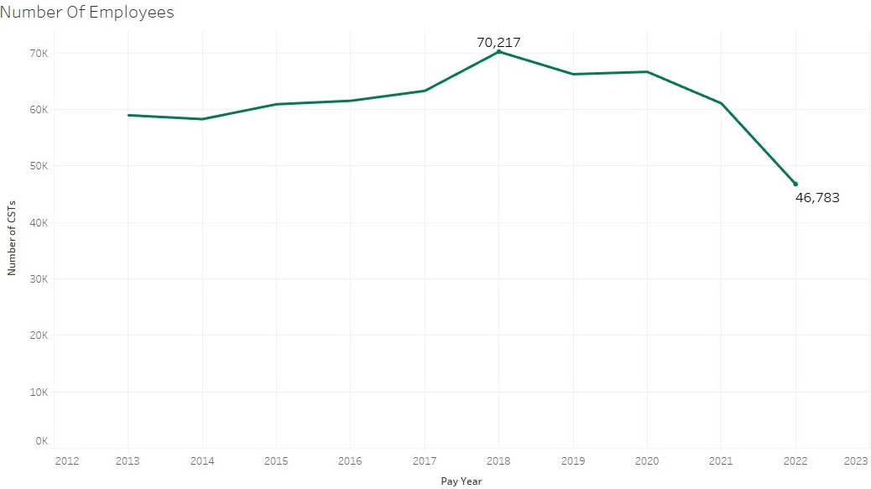
End Users + Features

Slide 20
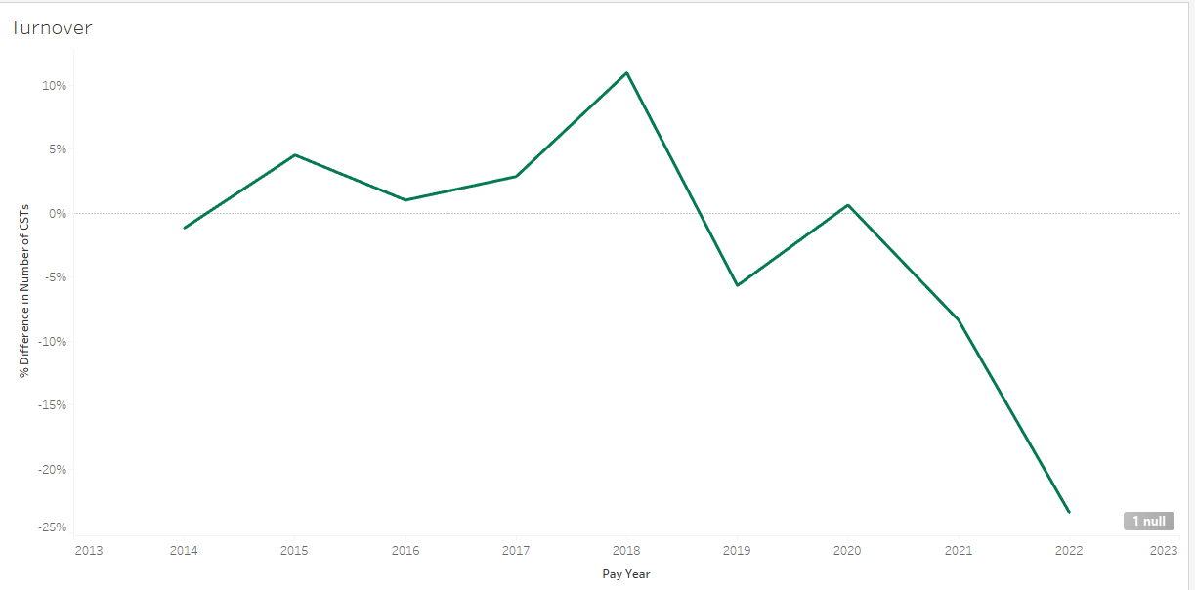
End Users + Features

Slide 21
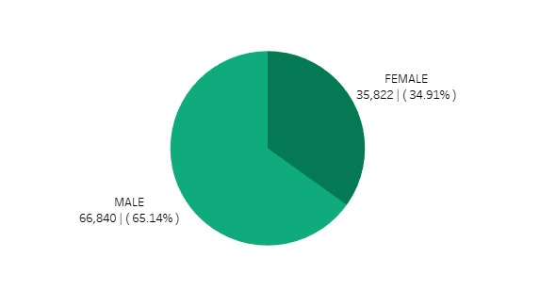
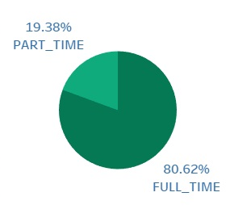
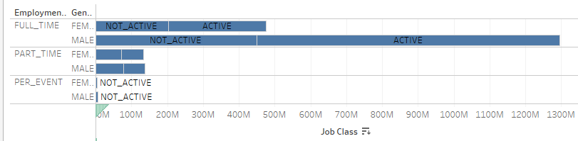
End Users + Features

Slide 22
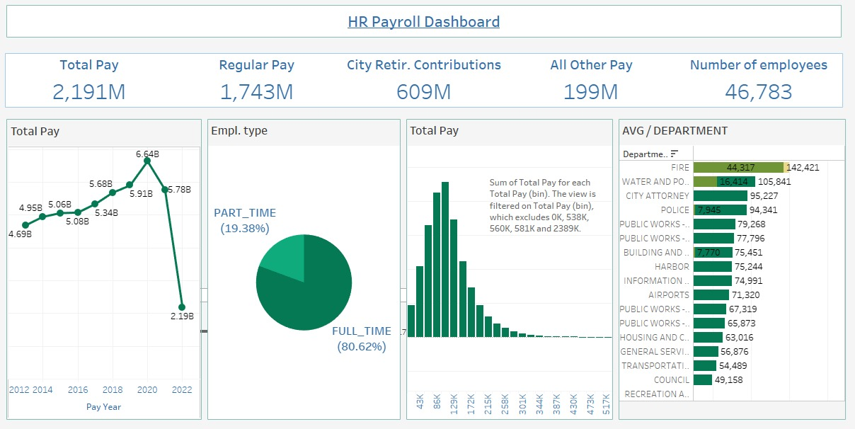
Project Wireframe
Visual Representation of Key User Interfaces:

Slide 23
Thank You
Contact information for follow-up
Invitation for questions or feedback

